Slide 1
Statistical Reasoning
MCB 293S:
Foundations of Biostatistical Practice
Week 2
Kelly Street
PhD Candidate
Division of Biostatistics
Dr. Sandrine Dudoit
Department of Statistics
Division of Biostatistics

Slide 2
Inferential Thinking
Drawing conclusions while accounting for uncertainty

Slide 3
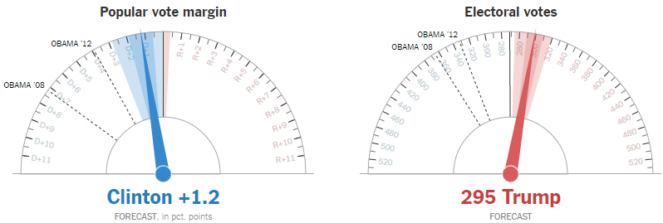
Uncertainty
https://www.nytimes.com/elections/forecast/president

Slide 4
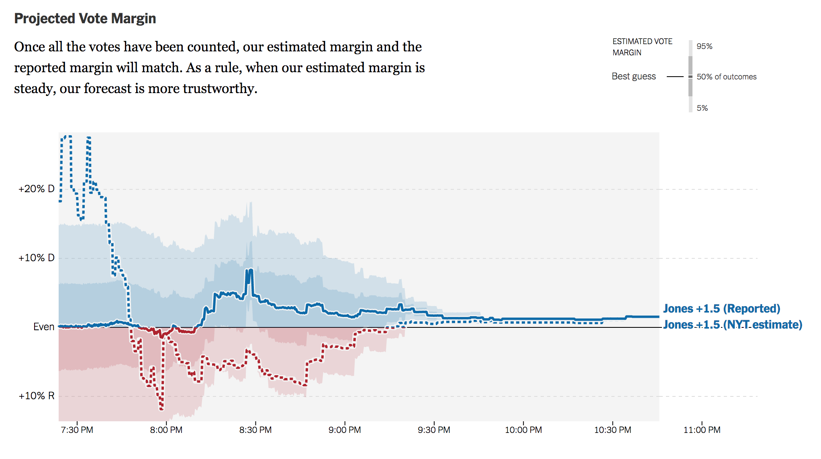
Uncertainty
https://www.nytimes.com/elections/results/alabama-senate-special-election-roy-moore-doug-jones

Slide 5
Inferential Thinking
Unlike elections, science will always have uncertainty.
In the election “experiment,” the population of interest is all registered voters and we can count every vote. In the lab, our population of interest might be “all fruit flies” or “all ES cells,” but we will only have access to a relatively small percentage.
Then how can we ever be sure of our conclusions?
We can’t. But that’s OK. Our knowledge increases incrementally and it’s better to be honest than certain. After enough evidence is gathered, you can be reasonably sure.

Slide 6
Inferential Thinking
10:23pm: Associated Press calls the election for Jones.
https://www.nytimes.com/elections/results/alabama-senate-special-election-roy-moore-doug-jones
Notes:
Not certain, but pretty sure.

Slide 7
Inferential Thinking
Unlike elections, science will always have uncertainty.
In the election “experiment,” the population of interest is all registered voters and we can count every vote. In the lab, our population of interest might be “all fruit flies” or “all ES cells,” but we will only have access to a relatively small percentage.
Then how can we ever be sure of our conclusions?
We can’t. But that’s OK. Our knowledge increases incrementally and it’s better to be honest than certain. After enough evidence is gathered, you can be reasonably sure.
It’s important to ask the right questions.
The first step in reaching a conclusion is asking a question that can be answered. We need to translate real-world scientific questions into statistical questions.

Slide 8
Parameter Estimation
Data:

Slide 9
Parameter Estimation
Data:

Slide 10
Parameter Estimation
Questions we can (kind of) answer about the POPULATION MEAN ( ):
(probably not)
(almost certainly not)
Data:
(maybe)

Slide 11
Parameter Estimation
Questions we can (kind of) answer about the POPULATION MEAN ( ):
What is our best guess?
What is a reasonable range of estimates?
Maybe 4 to 5?
Data:

Slide 12
Aside: Distributions
A distribution is a description of a random variable. It relates all possible outcomes to their respective probabilities.
Note that the sum of all the probabilities must equal 1.
Examples:

Slide 13
Quantifying Uncertainty
How can we measure what we do not know?

Slide 14
How to measure variability
-2.270262
1.40366

Slide 15
How to measure variability
2.270262
1.40366
Average Absolute Deviation

Slide 16
How to measure variability
5.15409
1.970261
Variance

Slide 17
How to measure variability
Sample Variance

Slide 18
How to measure variability
Variance is the average squared deviation from the mean.
The square root of the variance is the standard deviation.
This is the most common measure of spread (ie. noise, variability, instability).
An understanding of the variability is necessary to answer questions about the mean.

Slide 19
Parameter Estimation
Questions we can (kind of) answer about the POPULATION MEAN ( ):
(probably not)
(almost certainly not)
Data:
(maybe)

Slide 20
The Central limit theorem
I promise this is the only theorem.

Slide 21
The Central Limit Theorem

Slide 22

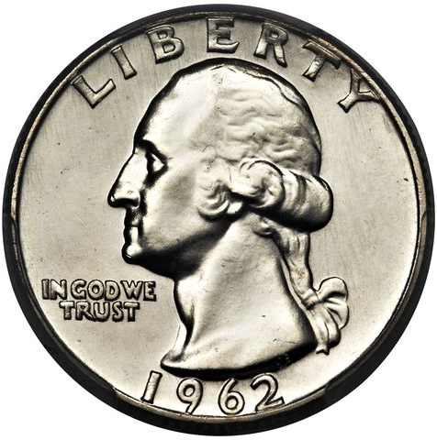
The Central Limit Theorem
Flip a fair coin 50 times and calculate the average number of heads.
> rbinom(1, 50, .5)

Slide 23
The Central Limit Theorem
Flip a fair coin 50 times and calculate the average number of heads 1,000 times.
0.54, 0.44, 0.52, …
> rbinom(1000, 50, .5)

Slide 24
The Central Limit Theorem
Flip a fair coin 25 times and calculate the average number of heads 1,000 times.
> rbinom(1000, 25, .5)

Slide 25
The Central Limit Theorem
Flip a fair coin 50 times and calculate the average number of heads 1,000 times.
0.54, 0.44, 0.52, …
> rbinom(1000, 50, .5)

Slide 26
The Central Limit Theorem
Flip a fair coin 100 times and calculate the average number of heads 1,000 times.
> rbinom(1000, 50, .5)

Slide 27
The Central Limit Theorem
Flip a fair coin 100 times and calculate the average number of heads 1,000 times.
0.54, 0.44, 0.52, …
> rbinom(1000, 50, .5)

Slide 28
The Central Limit Theorem
Flip a fair coin 50 times and calculate the average number of heads 1,000 times.
0.54, 0.44, 0.52, …
> rbinom(1000, 50, .5)
Normal distribution

Slide 29
The Central Limit Theorem
Given sufficient sample size, the sample average will follow a normal distribution centered at the true mean, with variance based on the true, population variance and sample size.
This is true of any population,
regardless of the shape of its distribution!

Slide 30
The Central Limit Theorem
Take samples of size 50.

Slide 31
The Central Limit Theorem
Take samples of size 100.
Notes:
10,000 replicates in histograms

Slide 32
Inference with the c.l.t.
Now we can actually start to answer some questions.

Slide 33
Hypothesis Testing
Questions we can (kind of) answer about the POPULATION MEAN ( ):
(probably not)
(almost certainly not)
Data:
(maybe)

Slide 34
Hypothesis Testing
“Classical”
Assume the true mean is 0. How well does this fit with our data?
Data:

Slide 35
Hypothesis Testing
“Classical”
Assume the true mean is 0. How well does this fit with our data?
Does our observed mean look like it was drawn from this distribution?
Not really. The probability of getting something this extreme would be about 0.0000082.
(that’s a p-value)

Slide 36
Statistical Questions
Questions we can (kind of) answer about the POPULATION MEAN ( ):
What is our best guess?
What is a reasonable range of estimates?
Maybe 4 to 5?
Data:

Slide 37
Confidence Intervals
“Classical”
What is a reasonable range of estimates for the POPULATION MEAN?
Data:
How confident do you want to be?
95% confidence interval

Slide 38
Conservation of Effort
“Classical”
A confidence interval tells you how any hypothesis test will turn out.
Data:

Slide 39
Confidence Intervals
“Modern”
What is a reasonable range of estimates for the POPULATION MEAN?
Data:
Treat the data like its own population.
In this population, we know the truth and we can sample as much as we want.
Sample from the data with replacement.
Notes:
Assumption: the sample approximates the population.
Advantage: we know the “truth”

Slide 40
Confidence Intervals
“Modern”
What is a reasonable range of estimates for the POPULATION MEAN?
Data:
Bootstrap sample:
How confident do you want to be?
95% confidence interval
Notes:
Assumption: the sample approximates the population.
Advantage: we know the “truth”

Slide 41
Recap
Estimates are only useful if we know how accurate they are.
Variability is an important determinant of accuracy.
The most common measures of variability are the variance and the standard deviation.
Variance: the average squared deviation from the mean
Standard deviation: the square root of the variance
The Central Limit Theorem tells us how the sample mean is distributed, which we use to perform inference.
We can perform hypothesis testing to evaluate assumptions about the mean.
We can construct confidence intervals representing a reasonable range of estimates for the mean. These can also tell us the results of any potential hypothesis tests.

